Slide 1
Java Servlets 01
Spring Valley Tech Corp ∙ Java SMP+ Teacher Training ∙ Jorge Cosgayon

Slide 2
Servlets
Servlets provide a component-based, platform-independent method for building Web-based applications, without the performance limitations of CGI programs. Servlets have access to the entire family of Java APIs, including the JDBC API to access enterprise databases.

Slide 3
Architecture
HTTP Server
App Server
Data Store
Servlets run on a Web or Application server and act as a middle layer between a requests coming from a Web browser or other HTTP client and databases or applications on the HTTP server.
Servlet
Browser

Slide 4
Servlet Tasks
Read the explicit data sent by the clients (browsers). This includes an HTML form on a Web page or it could also come from an applet or a custom HTTP client program.
Read the implicit HTTP request data sent by the clients (browsers). This includes cookies, media types and compression schemes the browser understands, and so forth.
Process the data and generate the results. This process may require talking to a database, invoking a Web service, or computing the response directly.
Send the explicit data (i.e., the document) to the clients (browsers). This document can be sent in a variety of formats, including text (HTML or XML), binary (GIF images), Excel, etc.
Send the implicit HTTP response to the clients (browsers). This includes telling the browsers or other clients what type of document is being returned (e.g., HTML), setting cookies and caching parameters, and other such tasks.

Slide 5
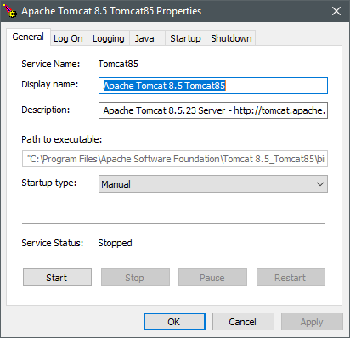
Setting up your dev environment
Install an app server like Apache Tomcat (this is different from the Apache web server)

Slide 6
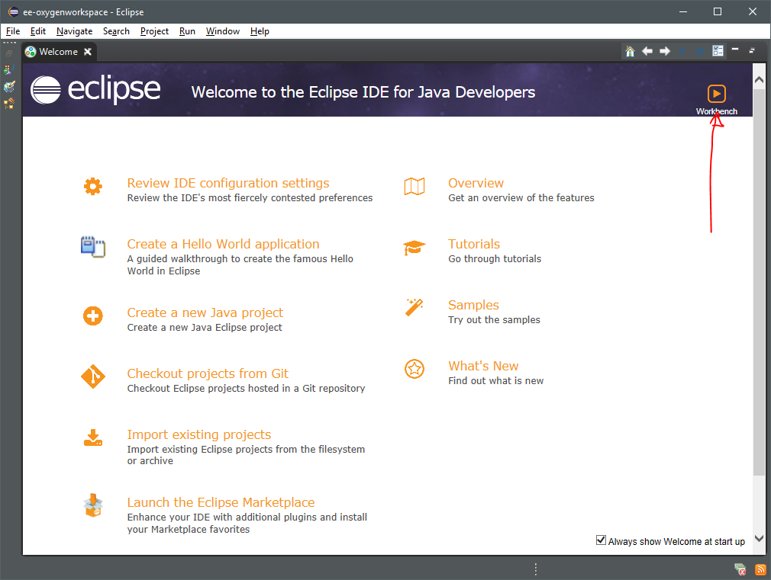
Setting up your dev environment
On the Eclipse EE welcome screen, click “Workbench”

Slide 7
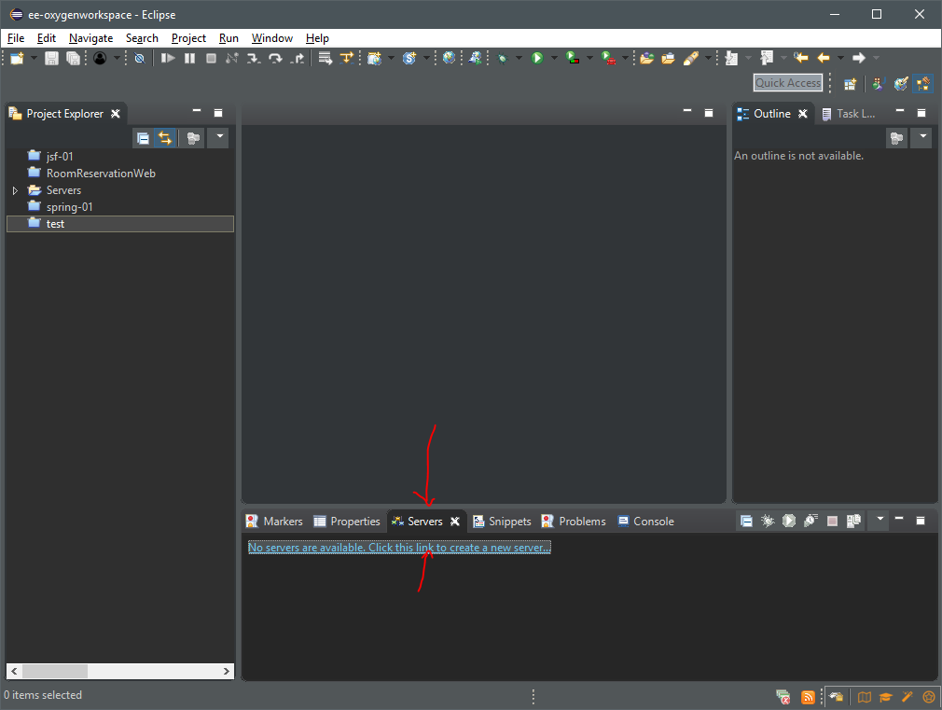
Setting up your dev environment
On the Servers tab, click on the link to create a new server

Slide 8
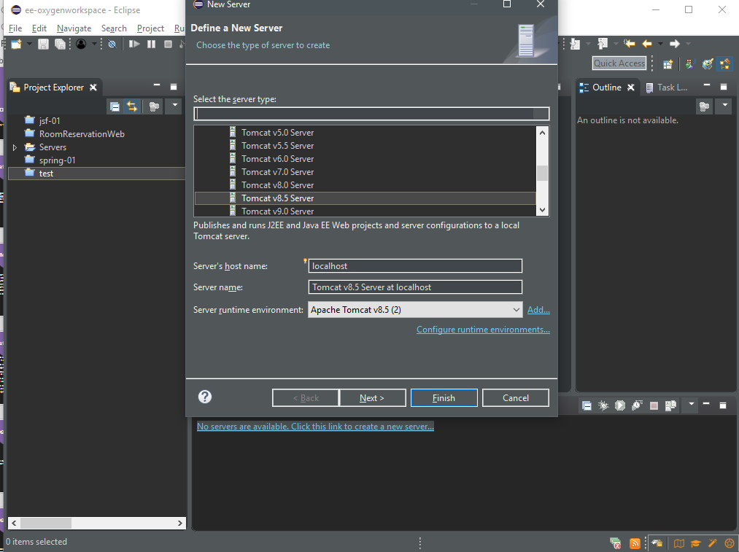
Setting up your dev environment
Select the server you’ve previously installed

Slide 9
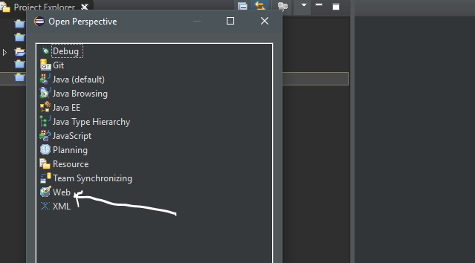
Setting up your dev environment
On Eclipse EE, make sure you are on the “Web” perspective

Slide 10
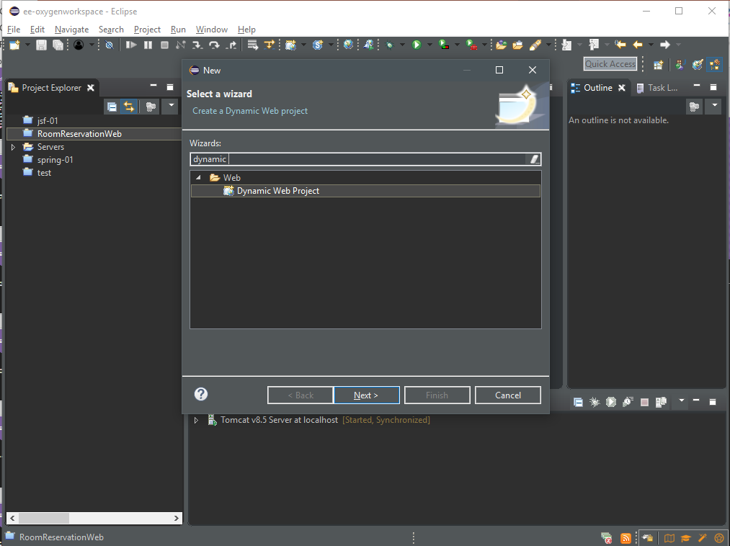
Writing our first servlet
Click on the File menu, and select “Dynamic Web Project” or search through the wizards.

Slide 11
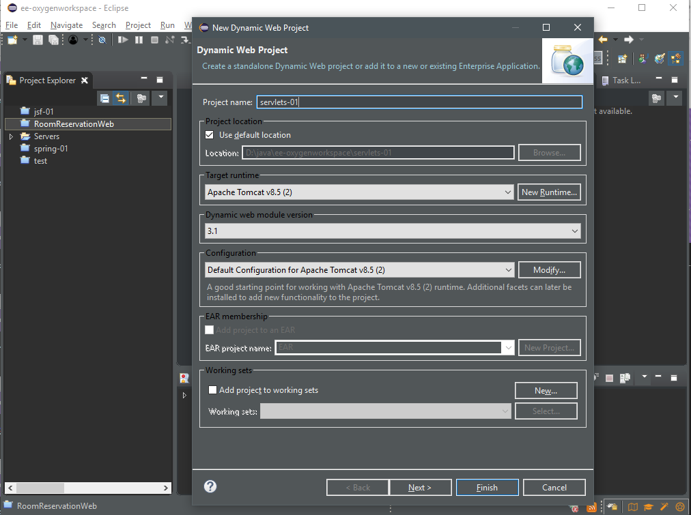
Enter the name of your project, make sure the application server you set up previously is selected

Slide 12
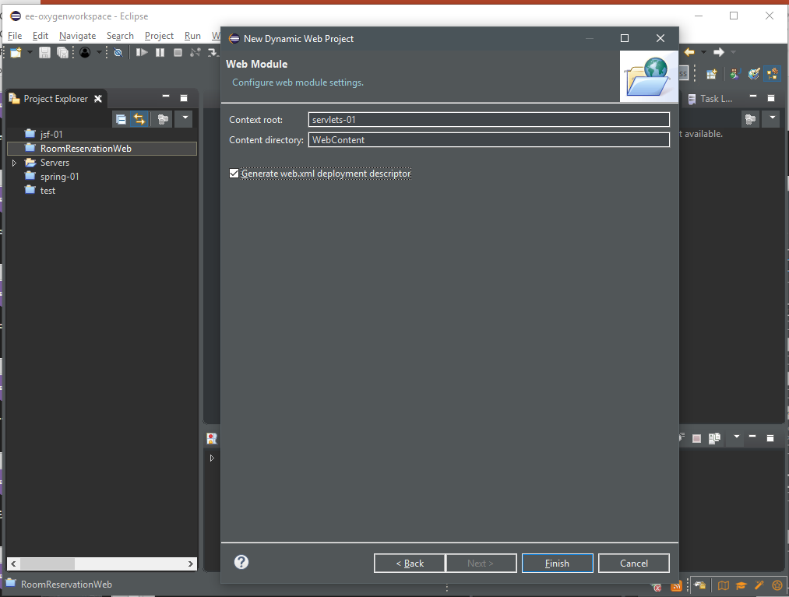
Make sure the web.xml deployment descriptor is checked

Slide 13
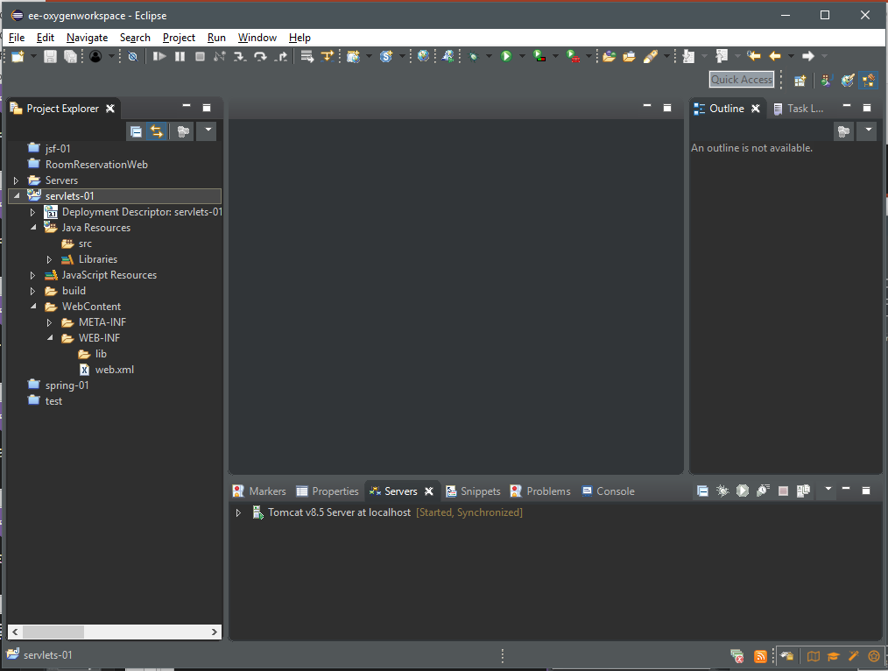
Your servlets will reside in the Java Resources/src folder
Your JSP, xHTML, and HTML files will be in the WebContent folder
External libraries will be copied to the WebContent/WEB-INF/lib folder

Slide 14
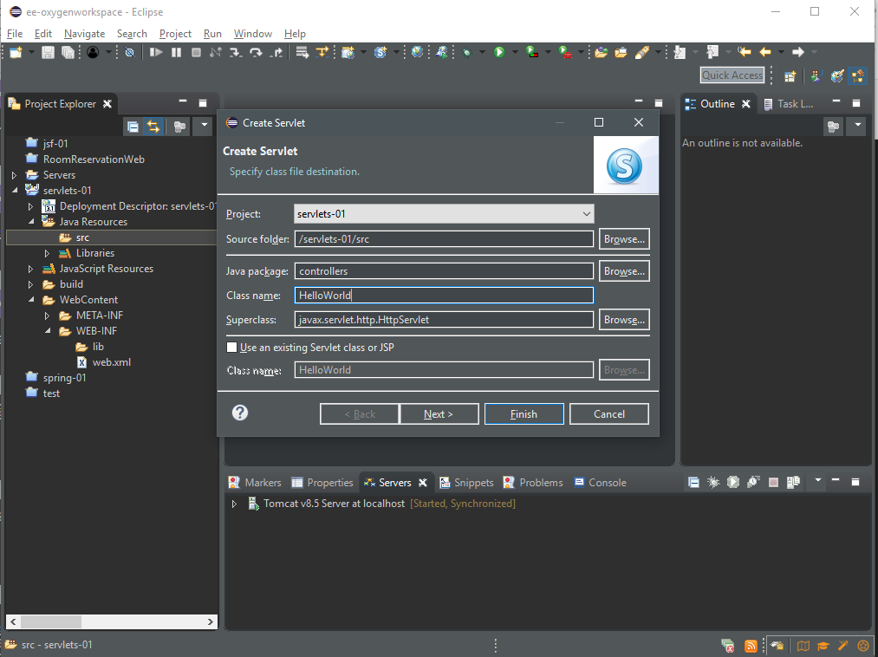
Right click on the src folder and choose “Servlet”
Let’s create a “controllers” package
… and name our class “HelloWorld”

Slide 15
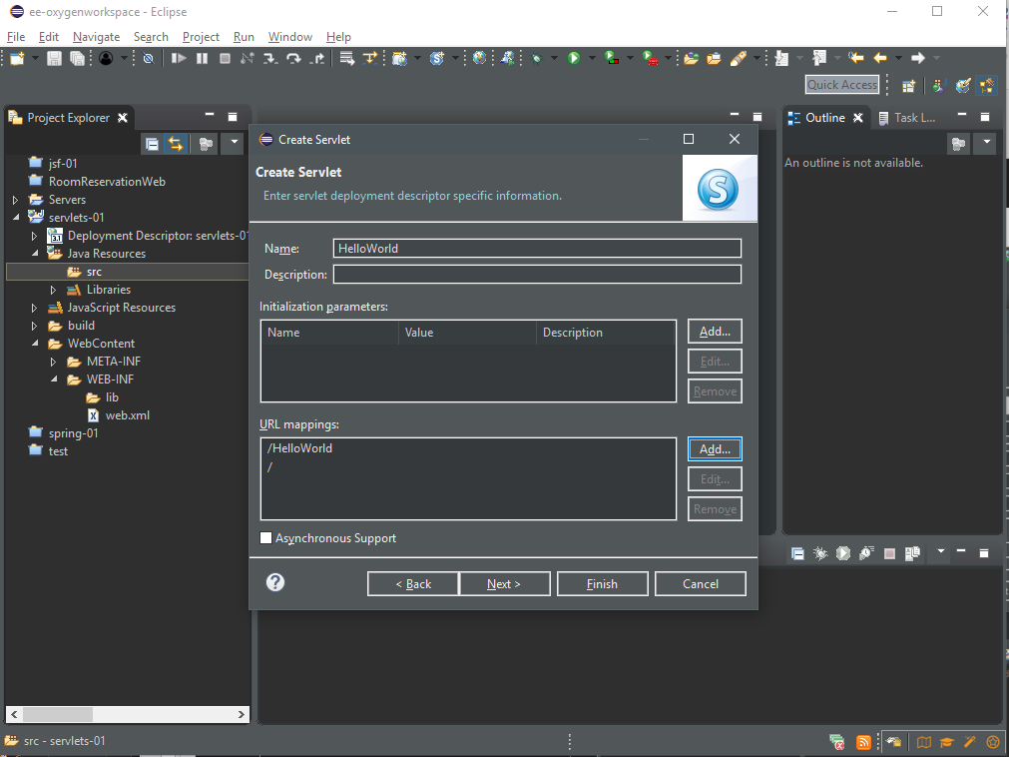
The URL mappings “map” the servlet to a URL we specify
Here, we can reach the class if we type HelloWorld and /
Typically, the server is http://localhost:8080
To access our app, we can write http://localhost:8080/servlets-01/HelloWorld or http://localhost:8080/servlets-01/

Slide 16
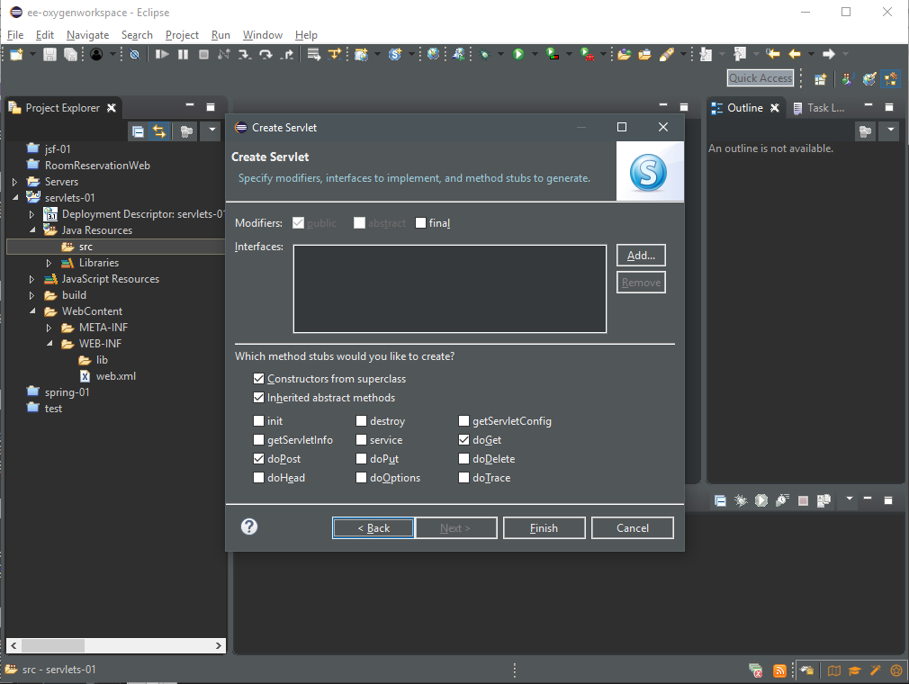
The doGet and doPost methods allow our servlet to handle GET and POST requests, respectively
The init method is useful if we want to initialize certain variables (usually to avoid null pointer exceptions)

Slide 17
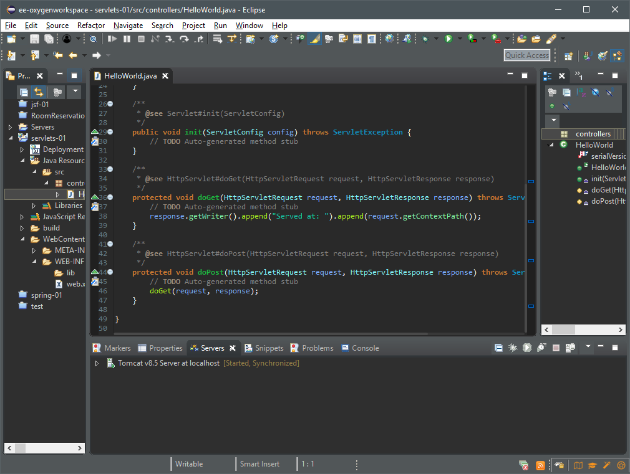
Here we see that Eclipse has already created some code for us
Note that both doGet() and doPost() have request and response parameters
The request parameter captures the data sent TO the servlet
The response parameter encapsulates the data the servlet sends OUT

Slide 18
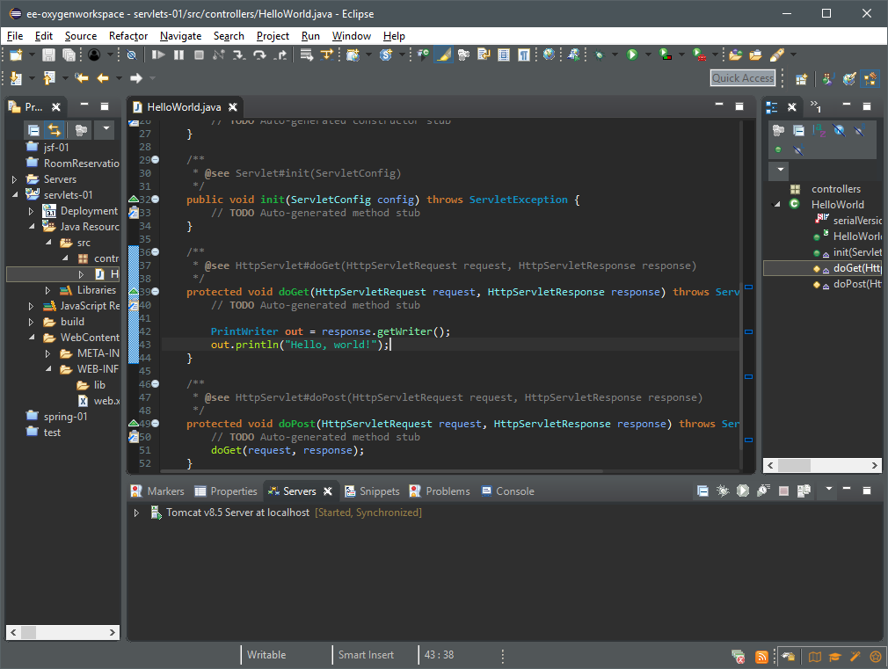
Let’s write our “Hello, world!”
And run the server

Slide 19
